Slide 1

Active Learning
So far we have assumed that the MDP is known. This is not the case for many real-world problems.
We need methods to learn a policy without knowing or estimating the MDP, so such methods are considered model-free.
Such learning is achieved by sampling paths through the MDP in order to collect information.
Monte-Carlo Tree Search is a kind of such sampling.
Monte-Carlo Policy Gradient (REINFORCE algorithm): An update to the policy parameters after a path is sampled.
Updates are favored for the parameters that enhance the probabilities of actions along paths with larger accumulated rewards.

Slide 2


Temporal Difference (TD) Learning
It is not necessary to do updates only after complete sample paths (episodes).
Idea: Use "estimated evaluations at future states" (which tend to be more accurate) to update the evaluation of the current state.
I can see better from here!
"Update" me with what you see!

Slide 3
Temporal Difference (TD) Learning
A basic TD learning step:
This is an actor-critic method in RL. (The "critic" is the supposedly better estimation from a subsequent state.)
Critic
Actor
Learning Rate
Discount Factor

Slide 4
Q-Learning
A really popular approach of reinforcement learning.
The algorithm follows the idea of TD learning.
Q-functions are action-value functions: Each entry, Q(s,a), represents the expected total reward of taking action a at state s.
The goal: To learn the Q-functions
When the learning converges, the best policy is to follow the action with the best Q value.
The "expected total reward" assumes that the best-Q-value action is taken for all subsequent steps until a terminal state is reached.
Q functions, like state-value functions, can be parameterized.

Slide 5
The Q-Learning Algorithm
Initialize all the Q values (for example, to zero).
A typical Q-learning procedure is to repeat the following many times (learning episodes):
Start at any valid initial state.
Repeat until a terminal state is reached:
Choose a valid action a from the current state s. Let s' be the resulting new state, and let r be the reward incurred for this action.
Update Q(s,a): (This occurs only for non-terminal s.)
Learning Rate
Discount Factor

Slide 6
Q-Learning Example
For simplicity, we will consider only a deterministic environment here, and all the Q values are initialized to zero.
Settings (state space given below): Start states = {A}. Learning rate = 1. Discount factor = 1. Terminal states = {E}.
B:0
0
D:0
0
A:0
0
0
0
0
0
C:1
E:5
0

Slide 7
Q-Learning Example
B:0
0
D:0
B:0
0
D:0
0
0
A:0
0
0
0
A:0
0
1
0
0
0
0
C:1
E:5
0
C:1
E:5
0
0
Action: A → B
Q(A, A→B) ← 0
Action: B → C
Q(B, B→C) ← 1 + max(0,0) = 1
B:0
0
D:0
0
0
new episode
0
B:0
D:0
A:0
0
1
0
A:0
0
0
1
0
0
0
C:1
E:5
6
C:1
E:5
5
5
Action: C → E
Q(C, C→E) ← 5
Action: A → C
Q(A, A→C) ← 1+ max(0,5) = 6

Slide 8
Q Tables
Q-table (the most common representation): A table of values of each combination of a state and a valid action from that state.
Convenient for problems with finite states and finite valid actions per state.
Quantization can be used for environments with continuous states and/or actions.
B:0
0
D:0
 | →A | →B | →C | →D | →E
A | - | 0 | 6 | - | -
B | - | - | 1 | 0 | -
C | - | 0 | - | - | 5
D | - | - | 0 | - | 0
E | - | - | - | - | -
0
A:0
0
1
0
0
6
C:1
E:5
5

Slide 9
Q-Learning: Exploration vs. Exploitation
Problem: During a training episode, how to choose the action from a state?
Best Q-value (greedy approach): Exploitation
Random action: Exploration
ε-greedy: Use a probability (ε) to choose between the two. (More exploration initially, and more exploitation later to facilitate convergence.)
(Optional) Adjustment of the discount factor: smaller initially (to avoid propagation of "noise") and larger later.

Slide 10
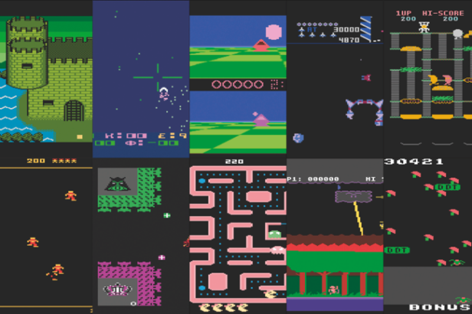
Deep Q-Learning
Use a neural network to represent the Q function.
The loss function (which leads to TD learning):
The network weights are updated via backpropagation.
DeepMind used DQL to make agents that play many Atari games to top human levels (2016).

